Slide 1
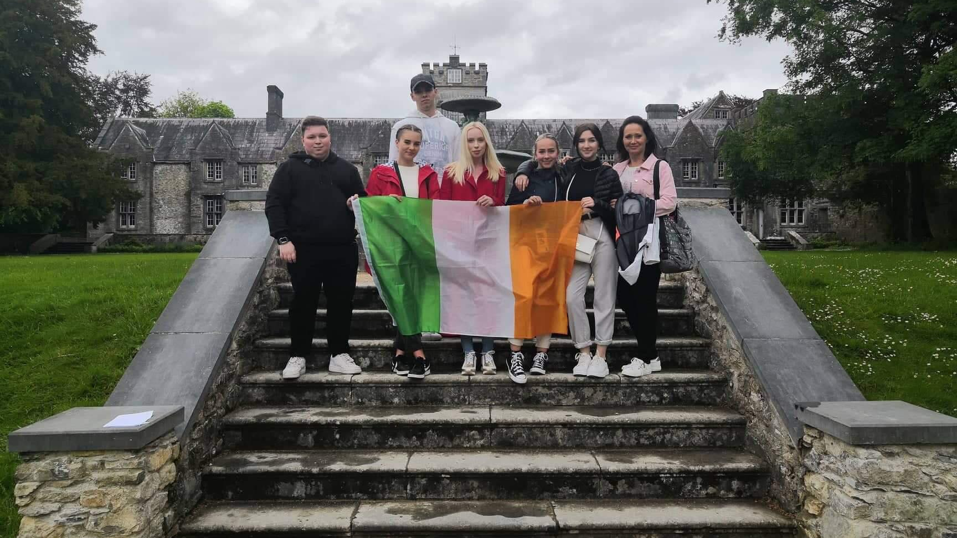
Stáž Irsko – Mallow
Nikol Reková M3.A
Číslo projektu: 2021-1-CZ01-KA121-VET-000010087​

Slide 2
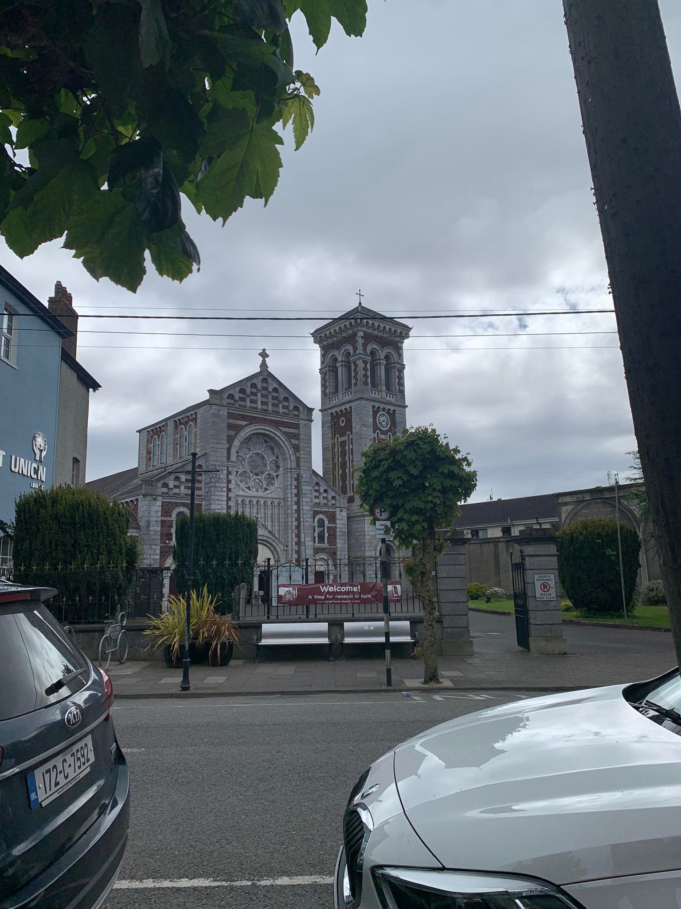
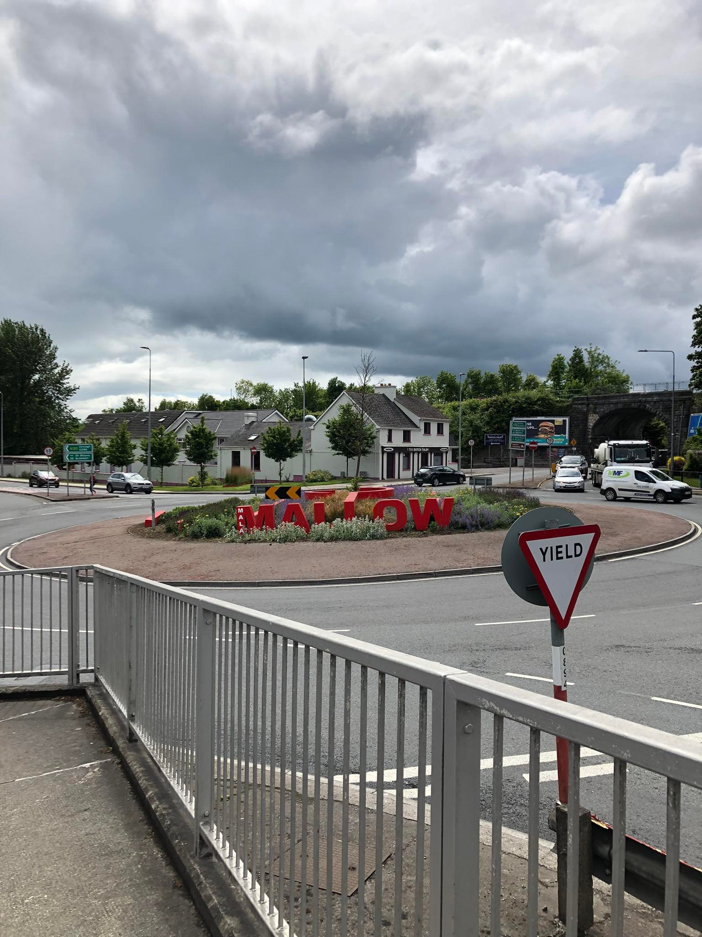
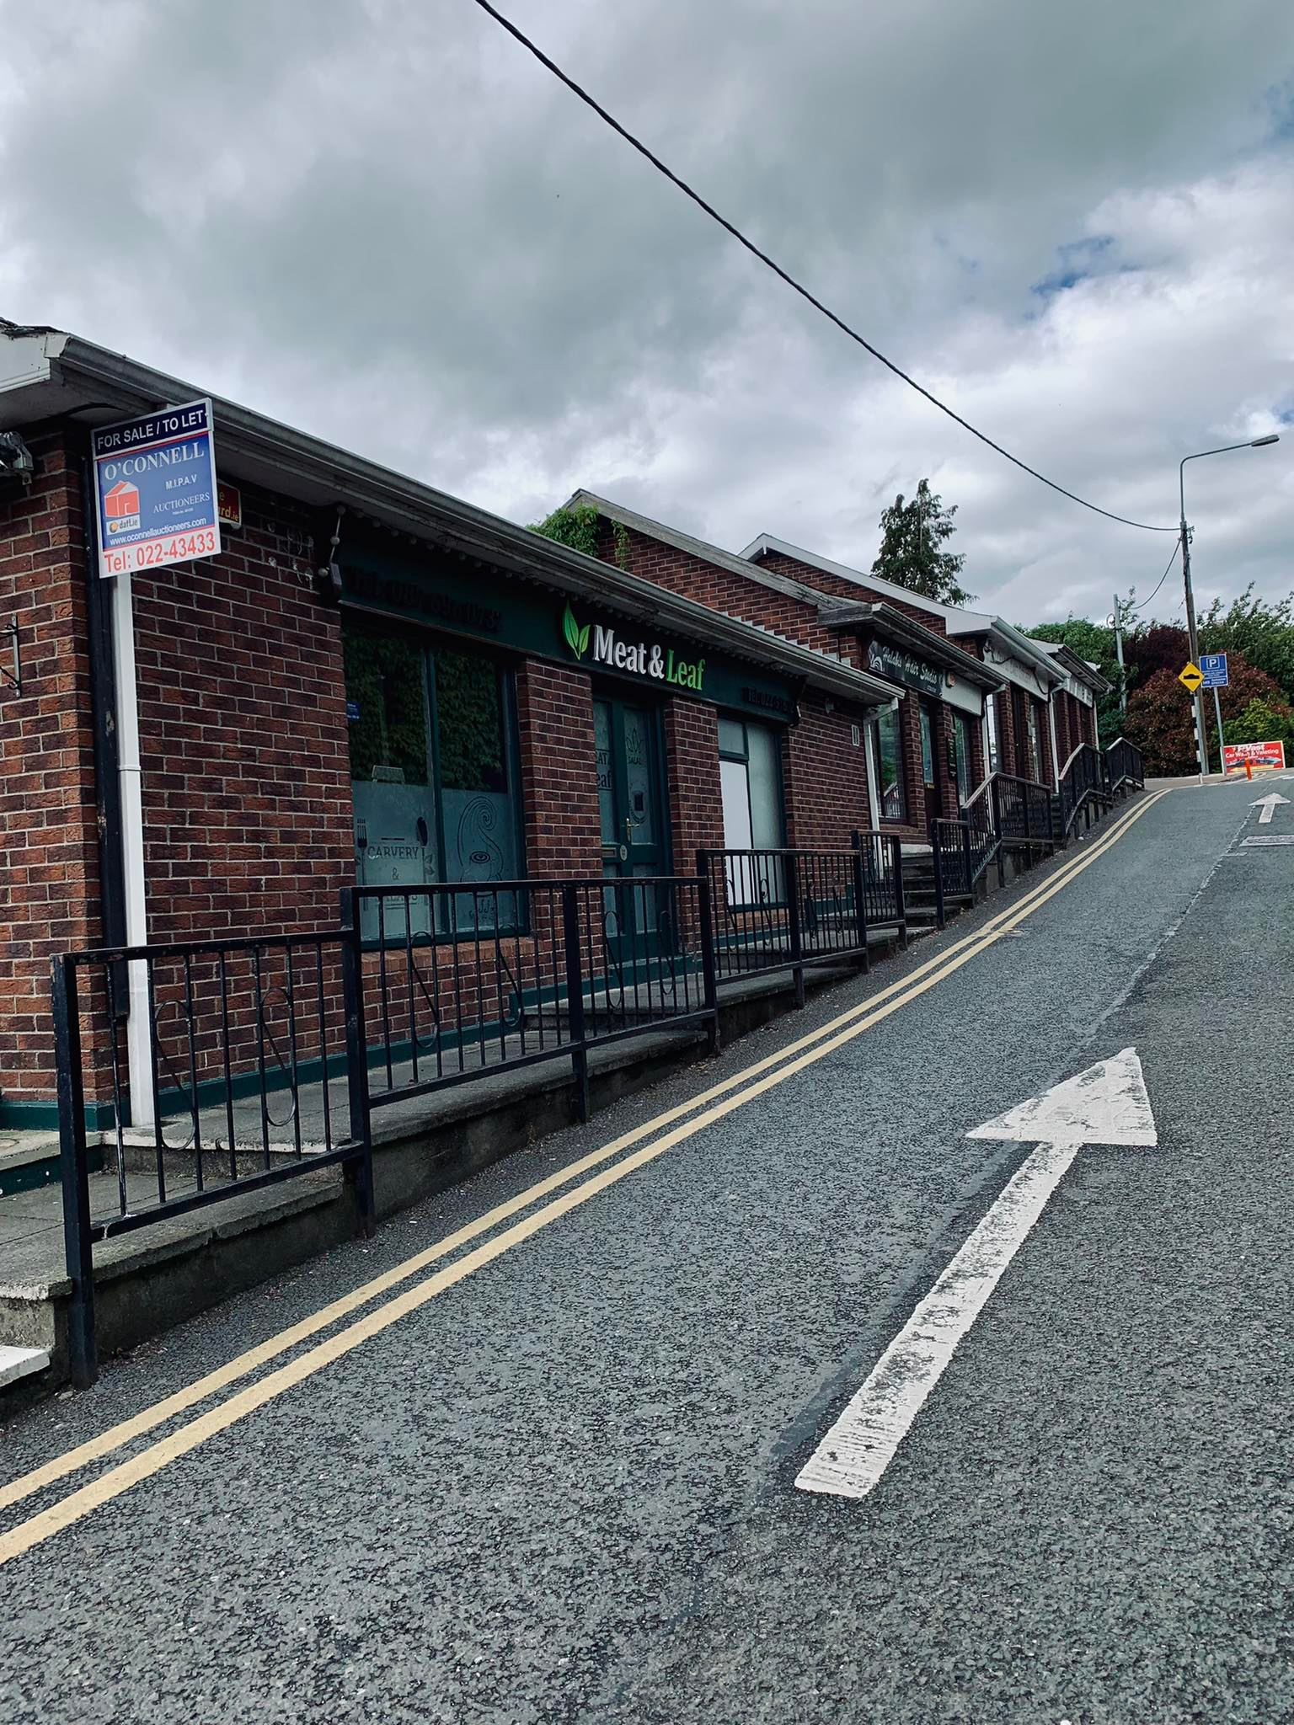
Mallow

Slide 3
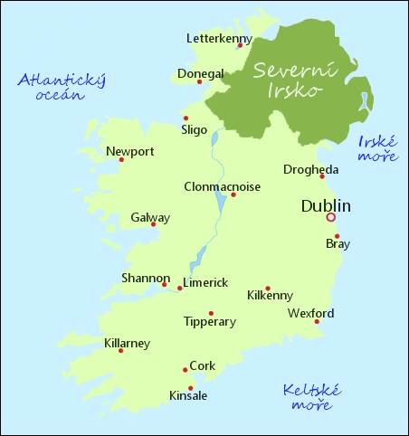
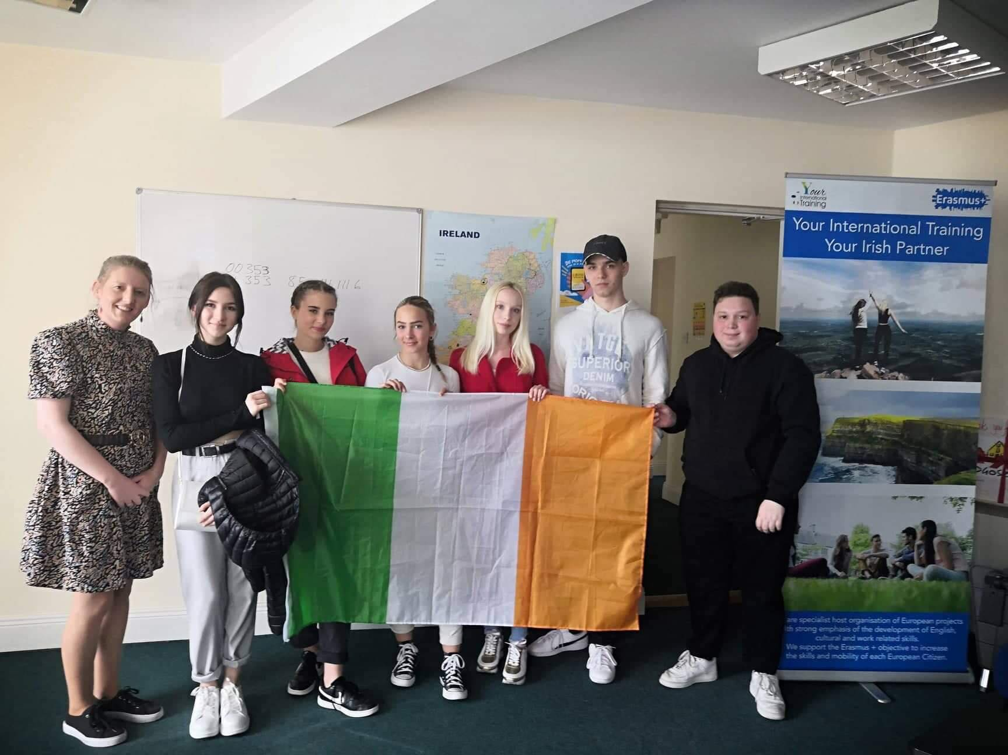
is a town in County Cork, Ireland, approximately thirty-five kilometres north of Cork. Mallow is in the barony of Fermoy.
It is the administrative centre of north County Cork, and the Northern Divisional Offices of Cork County Council are located in the town. Mallow is part of the Cork East Dáil constituency.
21.5.-10.6.2022

Slide 4
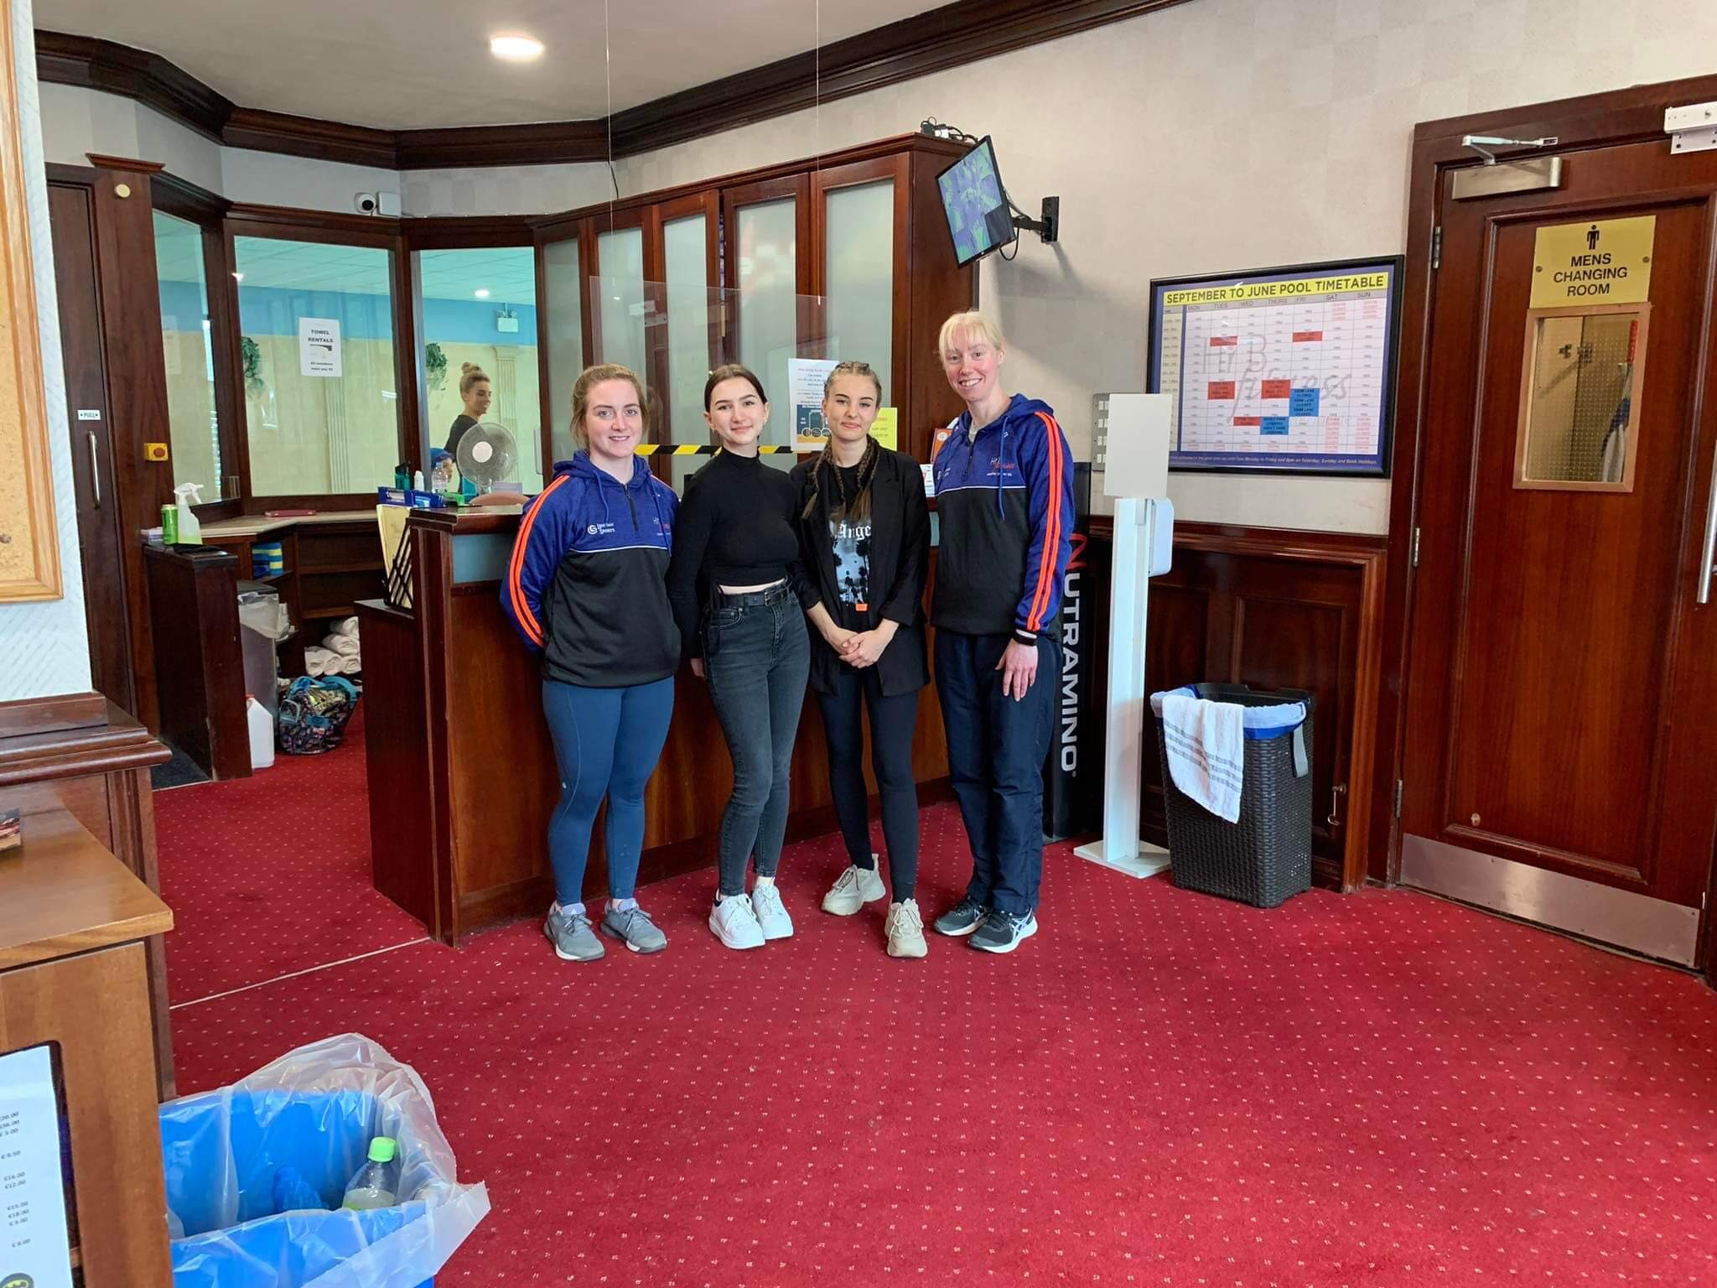
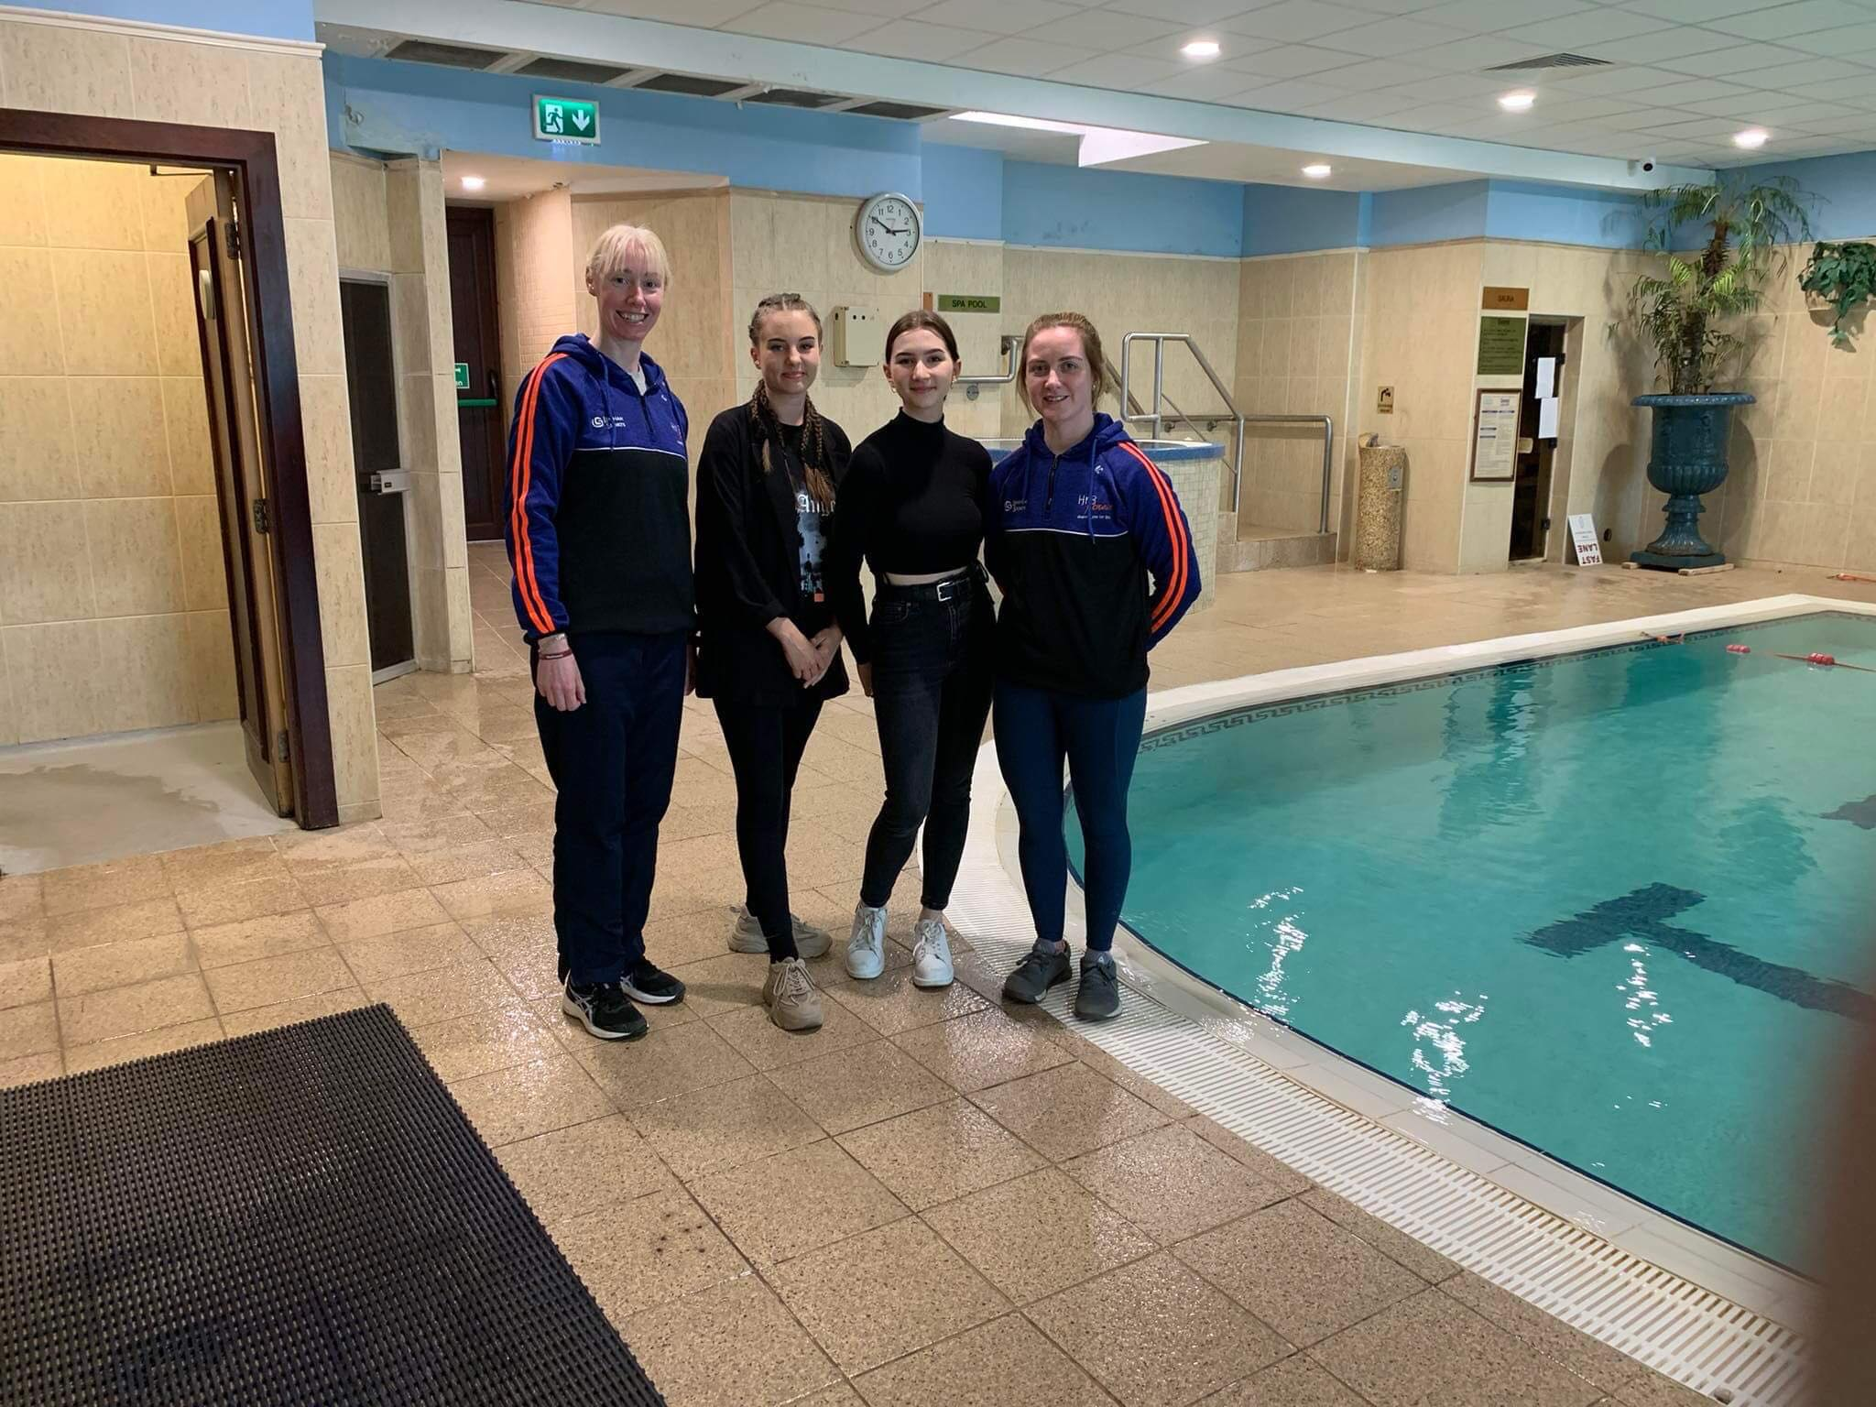
-Working with clients
-Teaching how to work out
-Taking care of their health
-Swimming lessons for kids
-Persolnal trainer
-paper works

Slide 5
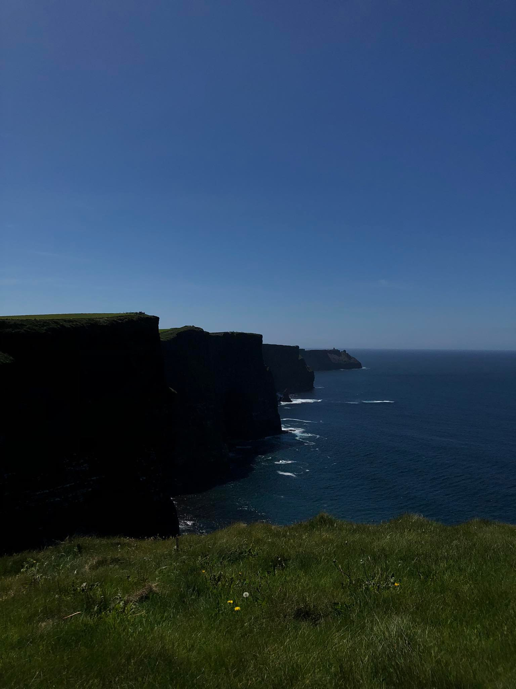
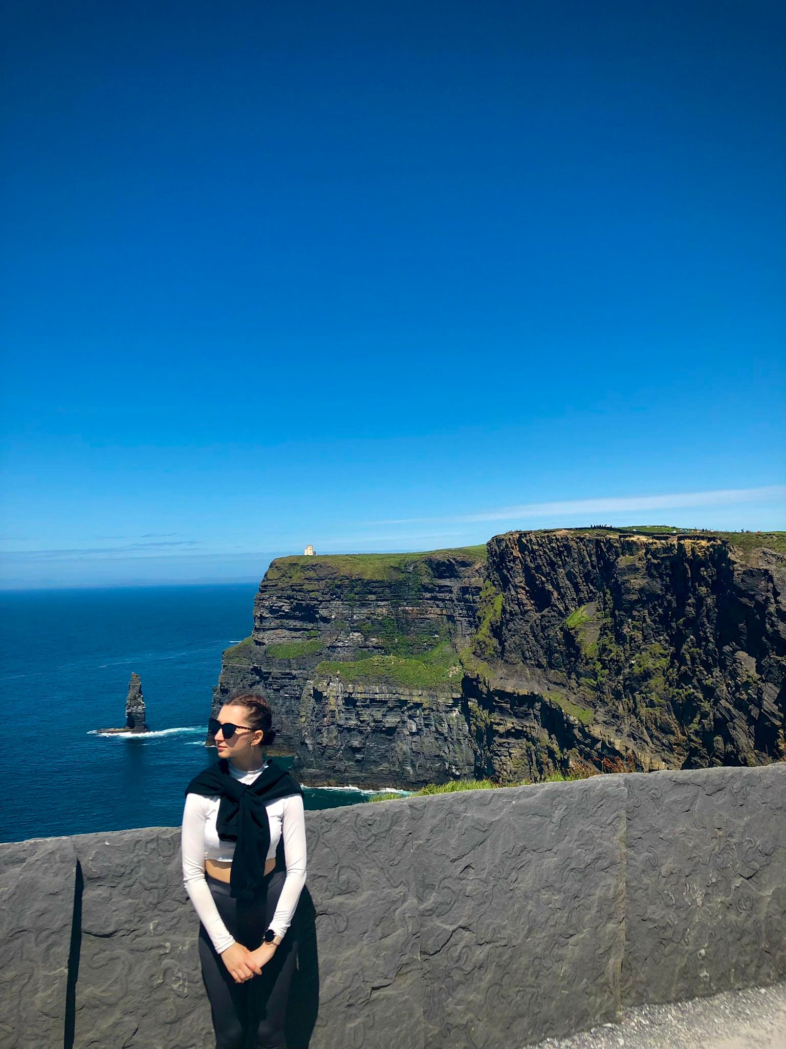
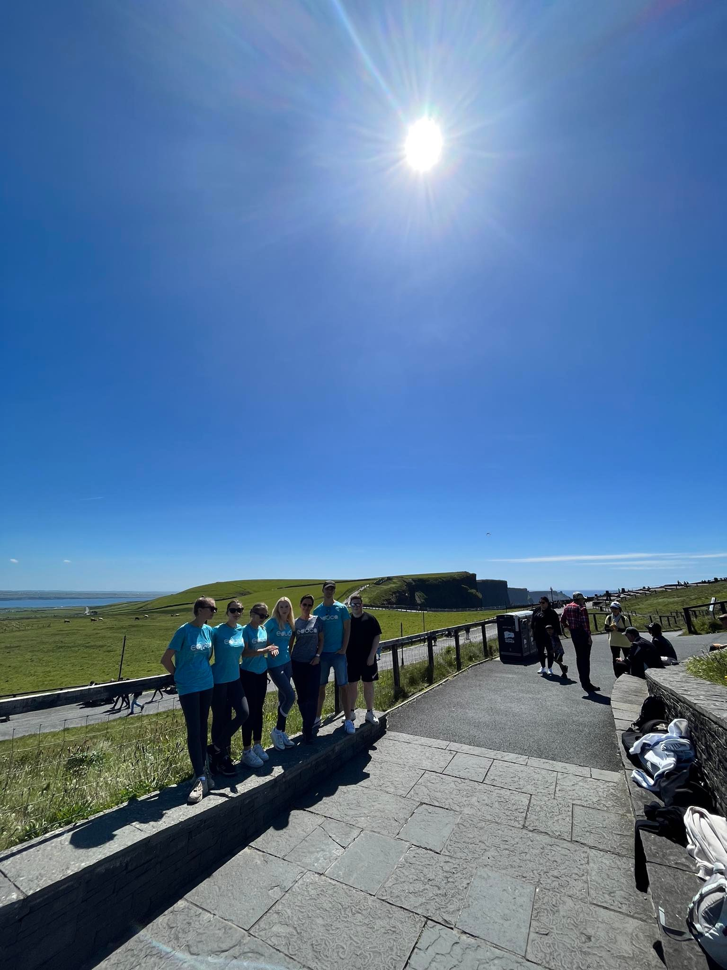
Cliffs of Moher

Slide 6
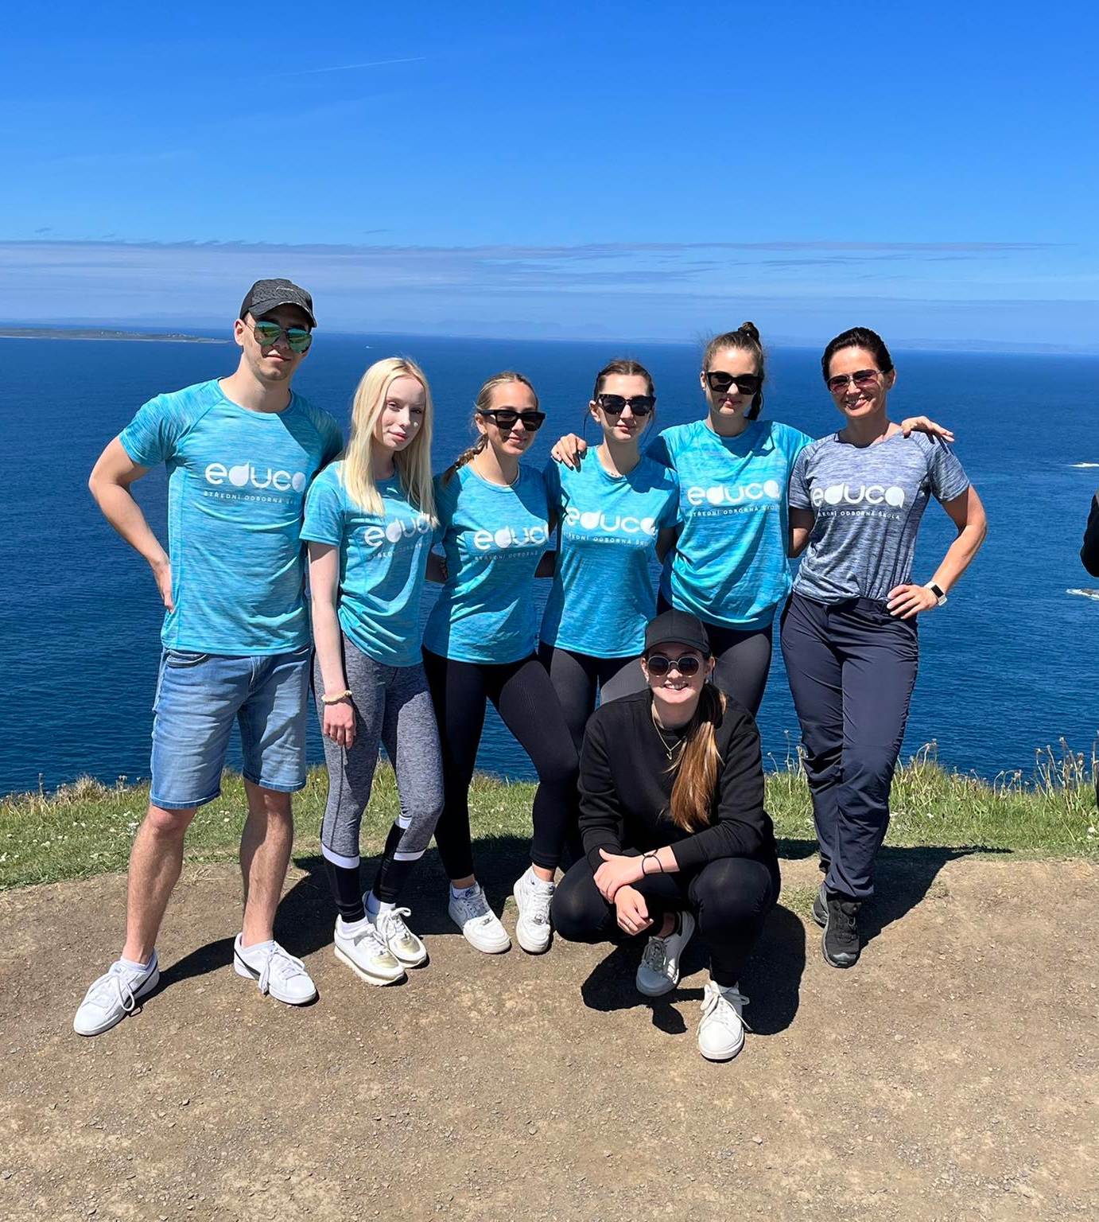
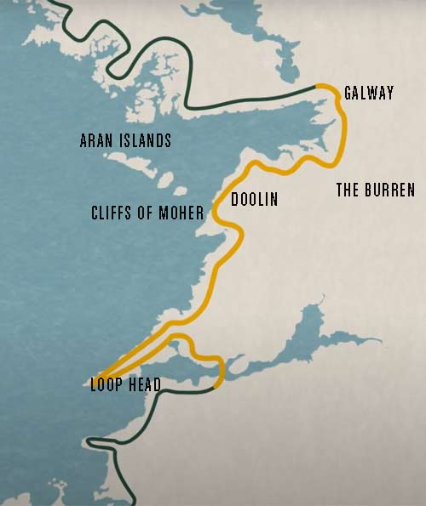
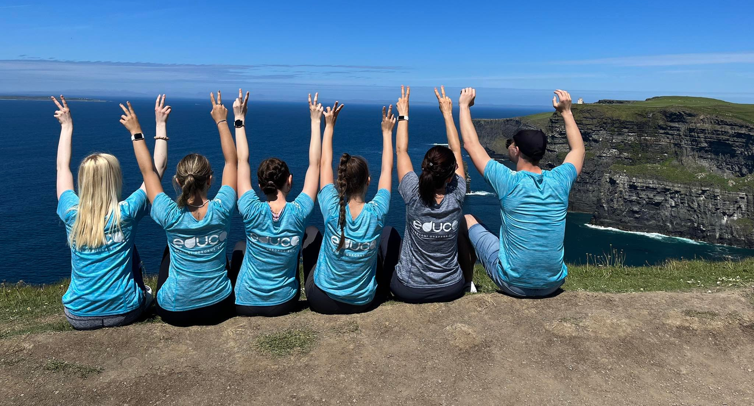
Situated on the Wild Atlantic Way on Irelands west coast the Cliffs of Moher are one of the most outstanding coastal features of Ireland. Rising slowly from Doolin village they ascend to over 700 feet (213 metres) boasting some of the most breathtaking scenery in Ireland. They have become one of Irelands premier tourist attraction and a must see for many people visiting Ireland.

Slide 7
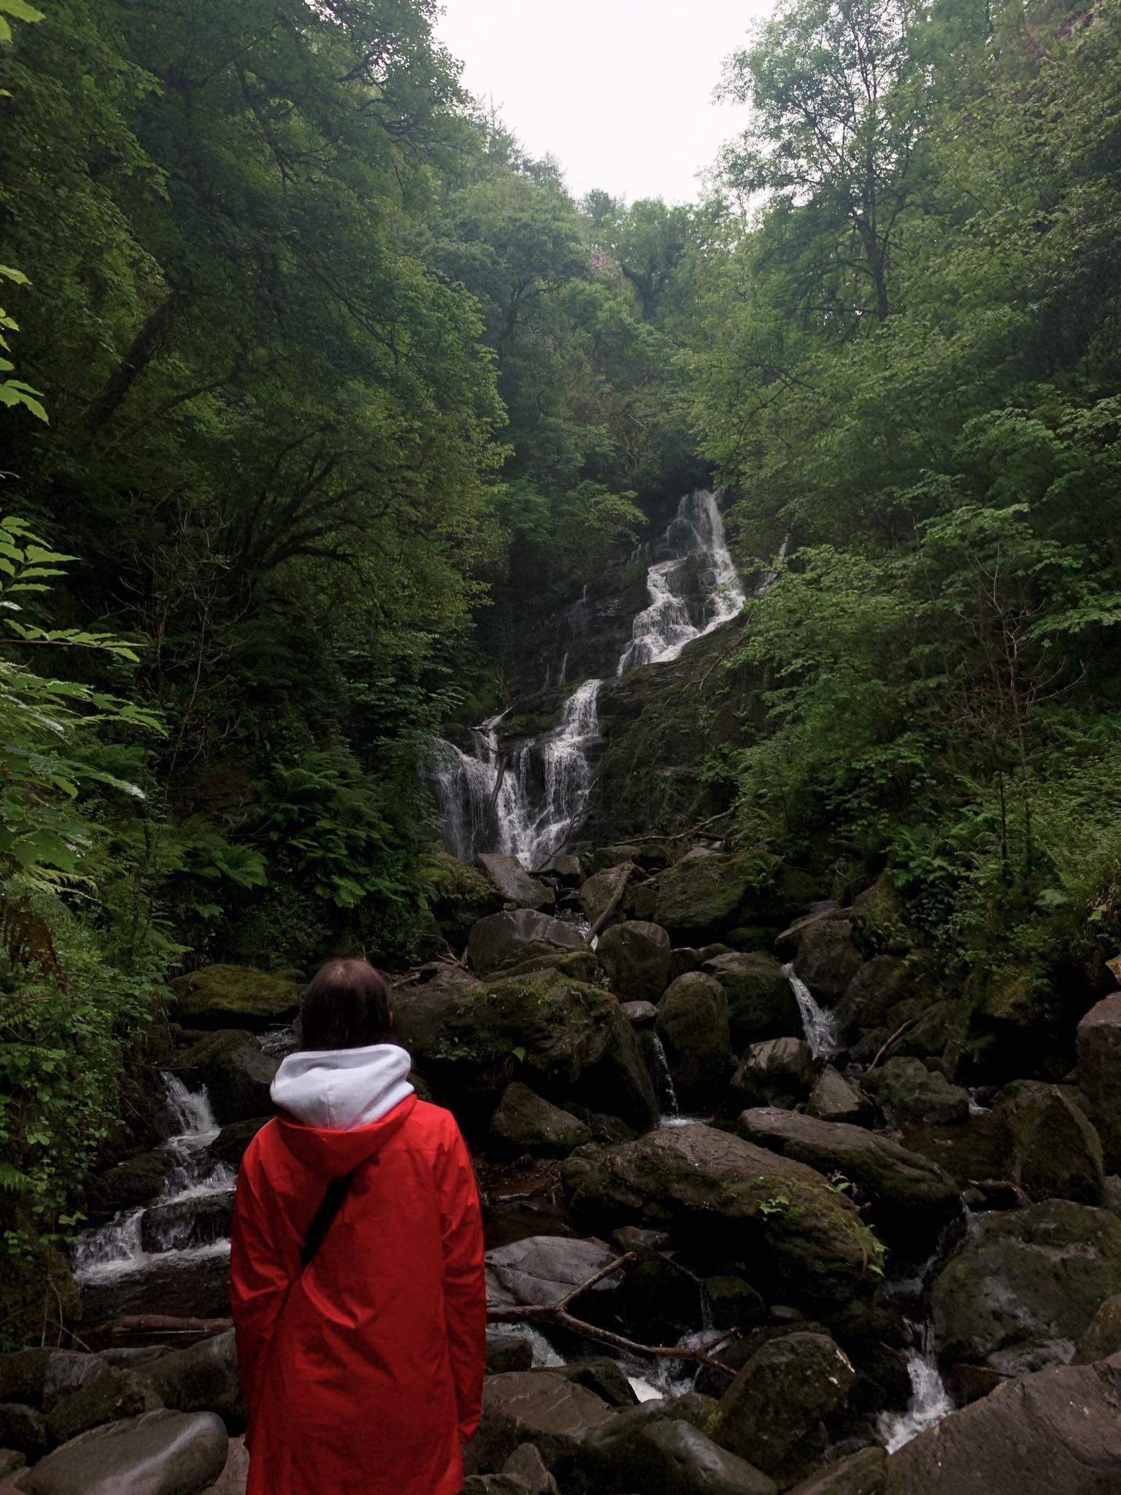
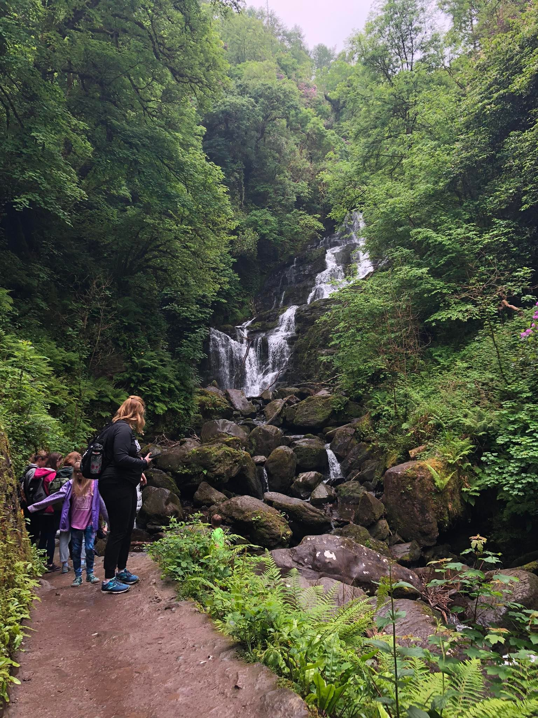
National park Killarney
Killarney National Park protects a vast landscape with lakes and a large, once typical Irish oak forest that became its foundation. It was established as the first ever national park in Ireland and was granted nature reserve status by UNESCO in 1982.

Slide 8
The internship was a great benefit for me thanks to my extensive work experience, but I also learned independence and improved my speaking in English
Thank you for the opportunity to be the part of the Erasmus +

